Slide 1


Recommendation System for tourist destinations using Natural Language Processing:
Group Members:
Zohaib Khan (19P-0095)
Ahmed Ali(19P-0042)
Project Supervisor:
Ms Salma Kalsoom

Slide 2

Introduction
Create a recommendation system for tourist in which user enter description about the place and after processing that data the application recommend them the places name in Khyber Paktunkwa.

Slide 3

MOBILE APPLICATION INTERFACE

Slide 4

Starting of application

Slide 5
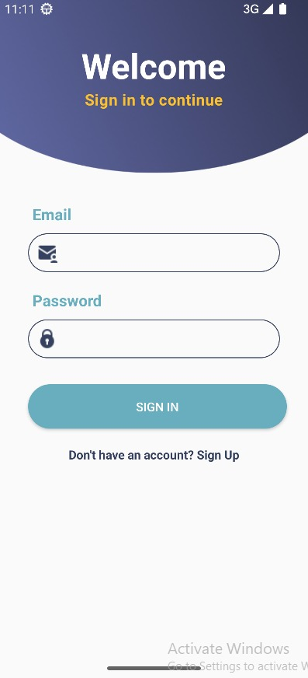
LOGIN PAGE:

Slide 6
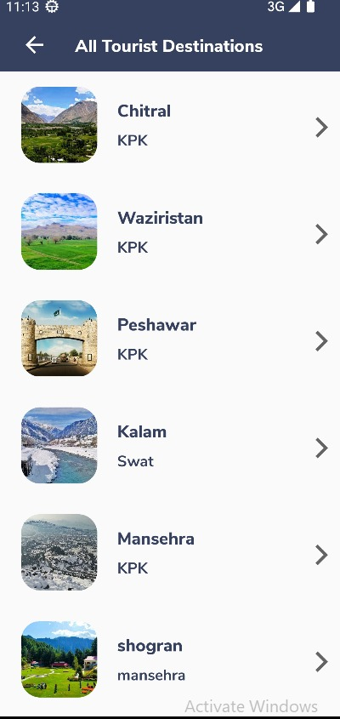
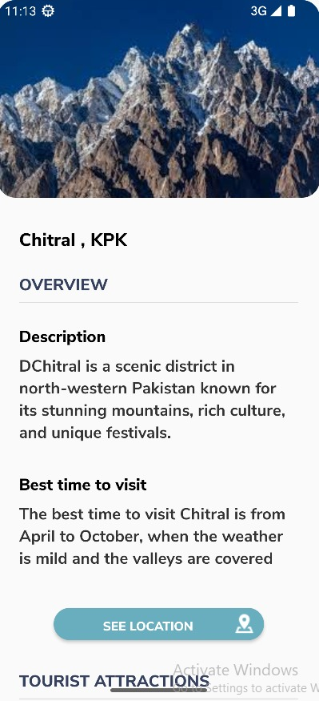
LOCATIONS AND DESCRIPTION:

Slide 7
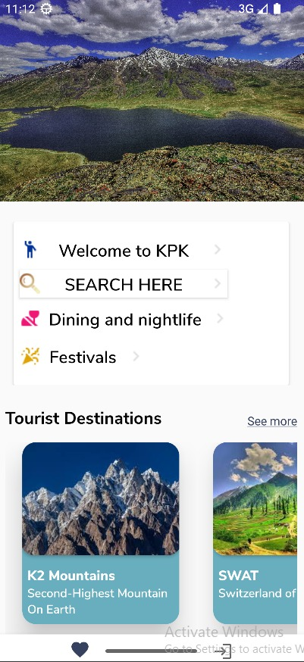
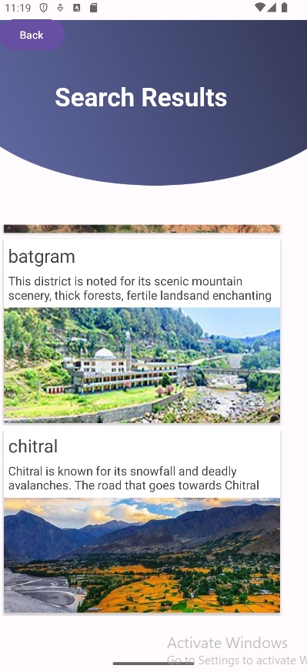
SEARCH BAR:

Slide 8
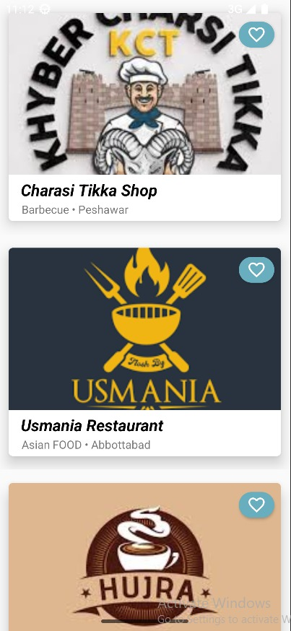
Restaurants:

Slide 9
Recommendations:

Slide 10
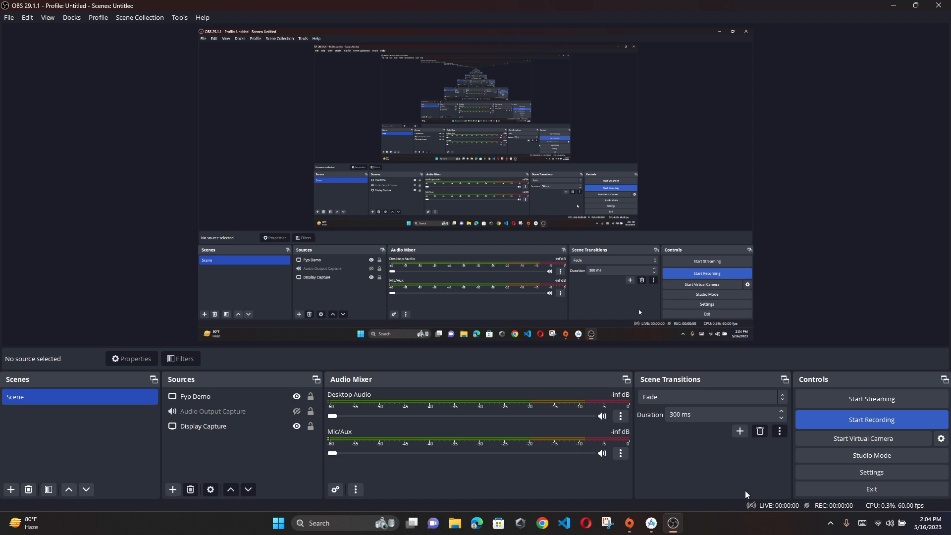
Video Demo

Slide 11
Goals
FYP-I
FYP-II
WORKING ON DIFFERENT STRATEGIES FOR BUILDING A RECOMMENDATION SYSTEM
IMPROVE RESULTS
MAKE CUSTOM DATASET
TRAINING OF MODEL
CREATING DATABASE AND FINDING ACCURACY
INTEGRATION OF MOBILE APPLICATION

Slide 12
System Architecture Design

Slide 13
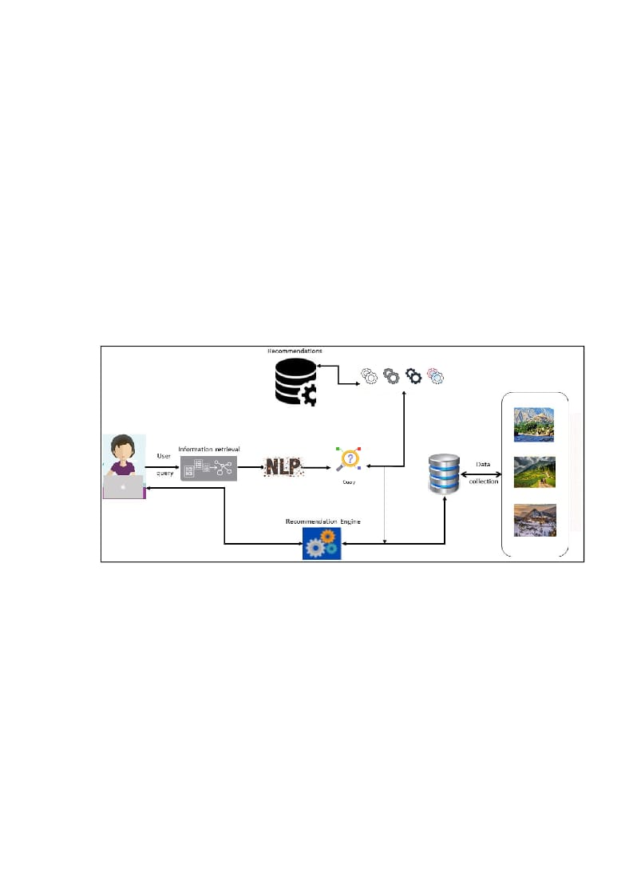
System Architecture Design:

Slide 14
TECHINCAL DIFFICULTIES

Slide 15
Lack of available dataset.
Lack of information about the places and events.
Face many difficulties while training our dataset.

Slide 16
TEAM WORK

Slide 17
Ahmed Ali
Zohaib Khan
Dataset Gathering
UML Diagrams
Literature Review
Creating Signup, Login pages of application.
API Connection
Database Creation
Application Testing
Request Handling
Documentation
Presentations
Literature Review
UML Diagrams
Code Preparation
Dataset Collection
Dataset Preprocessing
Model Training
Fine Tuning
28

Slide 18
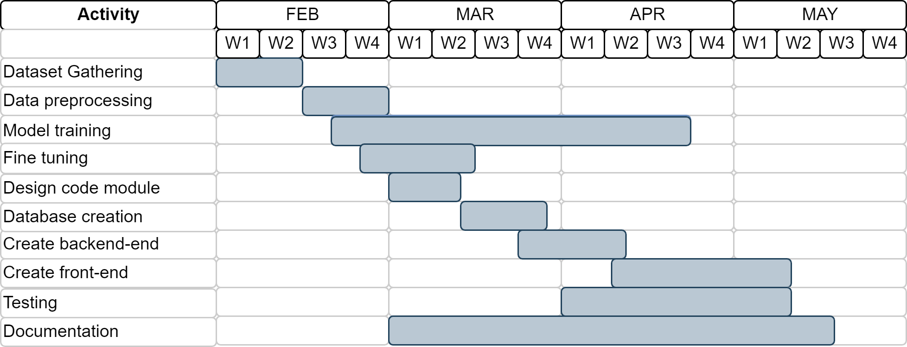
Timeline

Slide 19
Any Questions?

